Slide 1


Slide 2
 | Grade (S1-S3) | Numerical Mark (S4-S6) | Numerical mark 1 decimal S7 preliminary mark | Numerical mark 2 decimals S7 final mark | Performance Indicator
Excellent though not flawless performance entirely corresponding to the competences required by the subject | A | 10 9.0-9.5 | 9.0-10 | 9.00-10 | Excellent
Very good performance almost entirely corresponding to the competences required by the subject | B | 8.0-8.5 | 8.0-8.9 | 8.00-8.99 | Very good
Good performance corresponding overall to the competences required by the subject | C | 7.0-7.5 | 7.0-7.9 | 7.00-7.99 | Good
Satisfactory performance corresponding to the competences required by the subject | D | 6.0-6.5 | 6.0-6.9 | 6.00-6.99 | Satisfactory
Performance corresponding to the minimum of the competences required by the subject | E | 5.0-5.5 | 5.0-5.9 | 5.00-5.99 | Sufficient
Weak performance almost entirely failing to meet the competences required by the subject | F | 3.0-4.5 | 3.0-4.9 | 3.00-4.99 | Failed (Weak)
Very weak performance entirely failing to meet the competences required by the subject | FX | 0-2.5 | 0-2.9 | 0.00-2.99 | Failed (Very weak)
9-10 | The performance meets the requirements of the subject and the question particularly adequately. The mark 10 does not mean that the performance is flawless but it does denote a performance which is outstanding in all respects.
8-8.9 | The performance fully meets the requirements of the subject and the question.
7-7.9 | The performance generally meets the requirements of the subject and the question.
6-6.9 | The performance does show weaknesses but still meets the requirements of the subject and the question on the whole.
4-5.9 | The performance does not meet the requirements of the subject and the question but shows that the necessary basic knowledge exists and that the weaknesses can be remedied in the foreseeable future.
2-3.9 | The performance does not meet the requirements of the subject and the question, the basic knowledge being so sketchy that the weaknesses can be remedied only in the comparatively distant future.
0.1-1.9 | The performance does not meet the requirements of the subject and the question, the basic knowledge being so sketchy that the weaknesses cannot be remedied in the foreseeable future.
0 | This assessment will be given in the event of a blank or unacceptable script, of the absence of an answer or of a practical project or of cheating.

Slide 3
Timeframe for introduction
Step | School Year | Year Group
Step 1 | 2018-2019 | S1-S5
Step 2 | 2019-2020 | S6
Step 3 | 2020-2021 | S7

Slide 4
Attainment descriptors
A set of generic statements which describe levels of attainment in respect of a given set of competences or learning objectives.
Are related to the marking scale.
Are used for the planning of teaching, learning and assessment.
Can provide a basis for marking with the addition of some quality indicators.

Slide 5
New structure for Syllabi
Knowledge
Attitudes
Skills
1. General Objectives of the European Schools
2. Didactic Principles
3. Learning Objectives
4. Contents
5. Assessment
Attainment descriptors
6. Annexes
Sample Baccalaureate examination paper

Slide 6
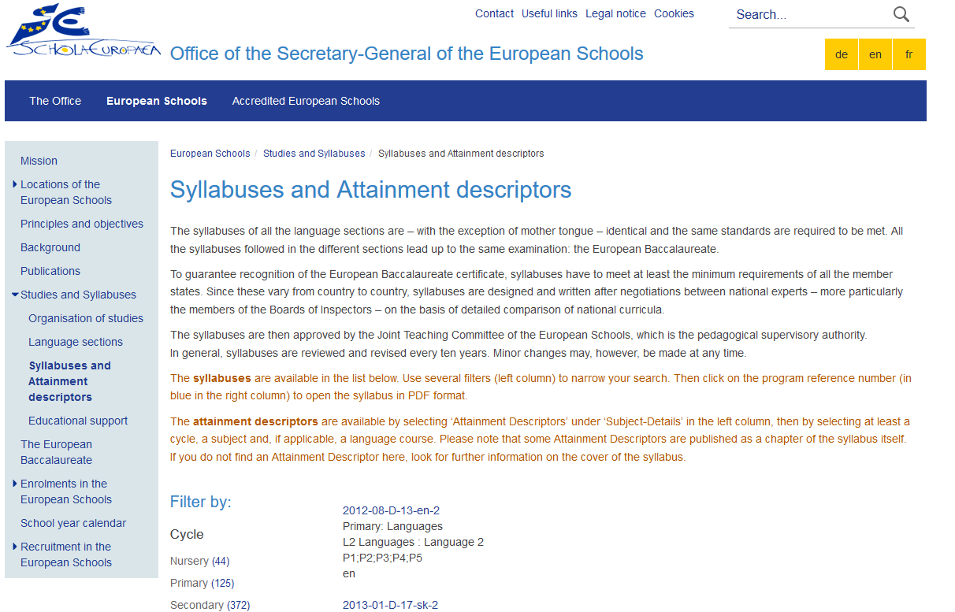

Slide 10
Teaching, Learning and Assessment
Syllabus
Learning Objectives
Teaching and Learning Activities
Assessment
Reporting
Planning for Teaching, Learning and Assessment
Evaluation/Review of Process

Slide 11


Implementation plan
1. Guidelines, including Generic examples
↓
2. Subject specific examples on 2 levels:
School based for Cycle 1 (S1-S3; 1st Training Day)
Inspectors led for S5 harmonized exam
↓
3. Centralised training of teacher trainers
↓
4. School-based training
(Separate meetings within schools; 2nd Training Day)
October 2017
Guidelines 2018-2019
(www.eursc.eu)
School year 2017-2018
Cycle 1
Cycle 2
School year 2018-2019
Cycle 3

Slide 12
Content table - Guidelines
1. Introduction
2. Marking System (see General Rules – Ref.: 2017-01-D-13-en-7)
3. Terminology
4.Planning for teaching, learning and assessment
4.1. Syllabuses
4.2 Planning
5. Assessment Tools and Assessment Tasks
5.1 Preparation process
5.2 Attainment Descriptors
5.3 Construction of assessment tools
5.4 Translation of test points into grades and/or marks
5.5 Final grades/marks at the end of the school year
6. School reports
7. Baccalaureate
8. Frequently asked questions
Annexes: Generic examples

Slide 13
Key Questions - Assessment
What do I want to assess (and for what reason)?
How will I assess?
What will my test look like?
How will I evaluate the student’s performance?
How will I report on performance/ overall performance?

Slide 14
Test design or test matrix

Slide 15
Marking schemes
Aspects for judgement | 5 points | 4 points | 3 points | 2 points | 1 point
Plan for Investigation | The plan is thorough. | The plan is lacking a few details. | The plan is just acceptable. | The plan is missing major details. | The plan is incomplete and limited.
Use of Materials | Manages all materials responsibly. | Uses the materials responsibly most of the time. | Use of the materials is just acceptable. | Mishandles some of the materials. | Does not use materials properly.
Collection of Data | Thorough collection, according to standards for research | Most of the data are available and collected according to standards for research. | Some of the data are available; research standards are not fully met. | Major portions of the data are missing; research standards are only partially met. | The data collection consists of a few points; research standards are not met.
Analysis of Data | Excellent analysis; standards of subject and of statistics are met in a professional way | Good analysis; standards of subject and statistics are mainly met. | Satisfactory analysis; standards of subject and statistics are met, but can be improved. | Sufficient analysis, but significant parts are missing; standards of subject and statistics are sufficiently met but deserve improvement | Poor analysis, standards of subject and statistics are hardly met and need improvement.
Reporting of Results | Communicates highly logically and concisely about hypotheses, investigation and results. Demonstrates excellent presentation skills. | Communicates clearly using scientific vocabulary correctly. Demonstrates good presentation skills. | Uses basic scientific vocabulary. Descriptions show satisfactory structure and clarity, but this can be improved. Demonstrates satisfactory presentation skills. | Uses basic scientific vocabulary. Descriptions lack structure and/or clarity; this deserves improvement. Demonstrates sufficient presentation skills, but skills deserve improvement. | Poor communication. Presentation skills need improvement.

Slide 16
Translation of test points into grades and/or marks

Slide 17
Final grades/marks – Assessment plan

Slide 18
Feedback
+ | -
Provided Power Point | Matrix
Guidelines very useful (Generic examples; holistic/analytcial approach; summative/formative assessment; Key questions assessment, FAQ) | Timeframe
Consultation/Cooperation/Cross-section meetings
Assessment Policy – ES
(A mark, B mark, Final mark – Number and type of assessment – Competence-based reporting – Self-assessment – Assessment plans)

Slide 19

Drop in standards?
6,0
A.D. – “Sufficient”
5,0
Student who would like to achieve a
“Satisfactory”
A.D.
6,0
6,0
“Sufficient”

Slide 20
BAC

