Slide 1
Extracurricular satisfaction survey 2019
Final results

Slide 2
305
Total Responses
Approximately 39% response rate

Slide 3
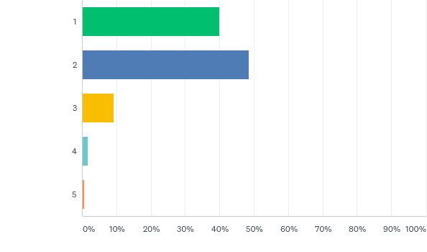
Q1: How many of your children attend the EEB3 School in Ixelles?
Answered: 291 Skipped: 14

Slide 4
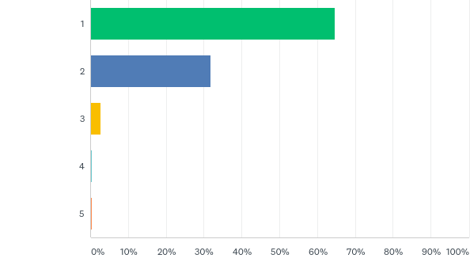
Q2: How many of your children attend the extracurricular activities organized by the APEEE?
Answered: 289 Skipped: 16

Slide 5
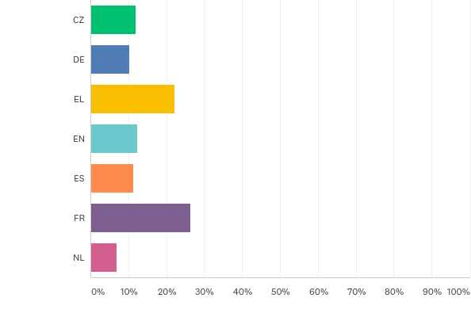
Q3: Please indicate which section your child(ren), enrolled for extracurricular activity(ies), attend(s)?
Answered: 292 Skipped: 13

Slide 6
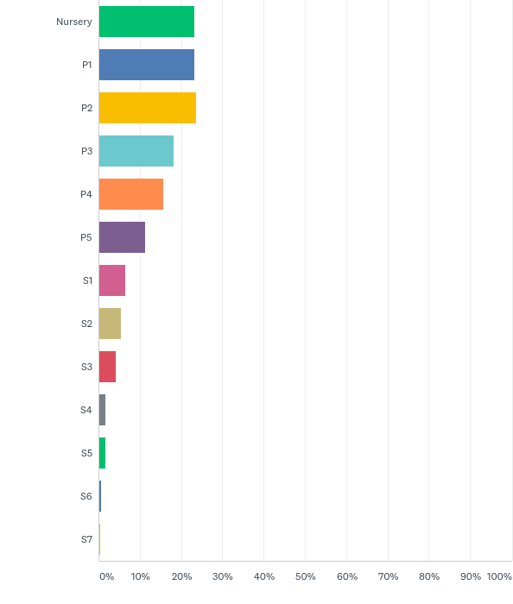
Q4: Please indicate which class your child(ren), enrolled for extracurricular activity(ies), attend(s)?
Answered: 292 Skipped: 13

Slide 7
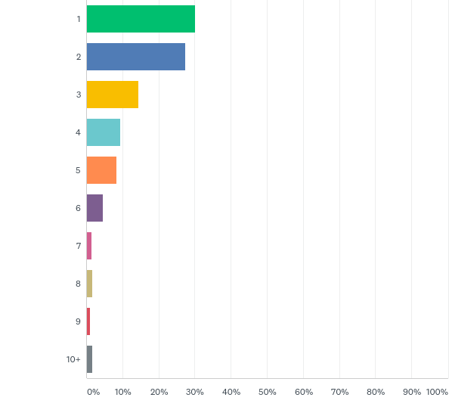
Q5: How many group extracurricular does your child(ren) attend(s) per week?
Answered: 289 Skipped: 16

Slide 8
Q7: Satisfaction with the nursery courses
Answered: 51 Skipped: 254

Slide 9
Q7: Satisfaction with the nursery courses
Answered: 51 Skipped: 254

Slide 10
Q7: Satisfaction with the nursery courses
Answered: 51 Skipped: 254

Slide 11
Q7: Satisfaction with the nursery courses
Answered: 51 Skipped: 254

Slide 12
Q7: Satisfaction with the nursery courses
Answered: 51 Skipped: 254

Slide 13
Q10, Q12, Q14, Q16 and Q18: Satisfaction with the primary courses
Answered: 364

Slide 14
Q10, Q12, Q14, Q16 and Q18: Satisfaction with the primary courses
Answered: 364

Slide 15
Q10, Q12, Q14, Q16 and Q18: Satisfaction with the primary courses
Answered: 364

Slide 16
Q10, Q12, Q14, Q16 and Q18: Satisfaction with the primary courses
Answered: 364

Slide 17
Q10, Q12, Q14, Q16 and Q18: Satisfaction with the primary courses
Answered: 364

Slide 18
Q20: Satisfaction with the secondary courses
Answered: 36 Skipped: 269

Slide 19
Q20: Satisfaction with the secondary courses
Answered: 36 Skipped: 269

Slide 20
Q20: Satisfaction with the secondary courses
Answered: 36 Skipped: 269

Slide 21
Q20: Satisfaction with the secondary courses
Answered: 36 Skipped: 269

Slide 22
Q20: Satisfaction with the secondary courses
Answered: 36 Skipped: 269

Slide 23
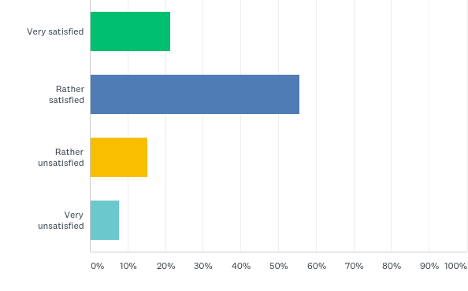
Q21: Are you satisfied with the registration process for the extracurricular activities?
Answered: 230 Skipped: 75

Slide 24
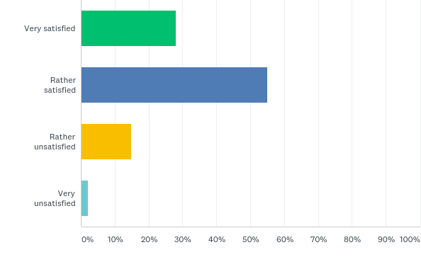
Q22: What is your overall satisfaction with the offer of the extracurricular activities?
Answered: 229 Skipped: 76

Slide 25
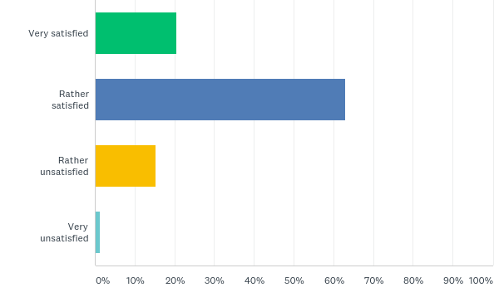
Q23: What is your overall satisfaction with the prices for the extracurricular activities?
Answered: 230 Skipped: 75

Slide 26
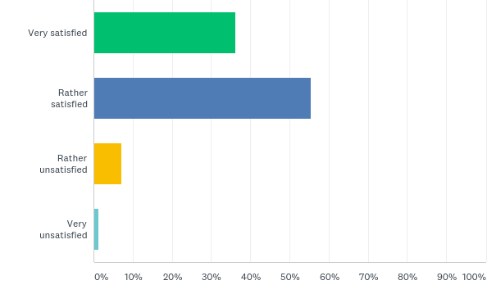
Q24: What is your overall experience with the APEEE office (attentiveness to children’s needs, responding to parent enquiries, solution providing, etc.)?
Answered: 227 Skipped: 78

Slide 27
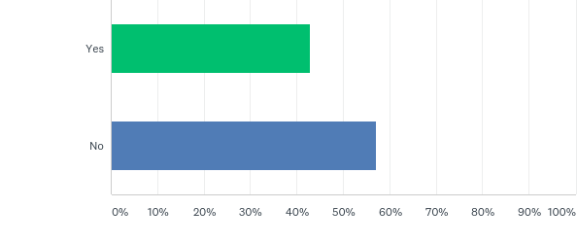
Q25: Do you wish to propose any additional extracurricular activity that could be included in the Extracurricular activity programme offered by the APEEE?
Answered: 221 Skipped: 84

Slide 28
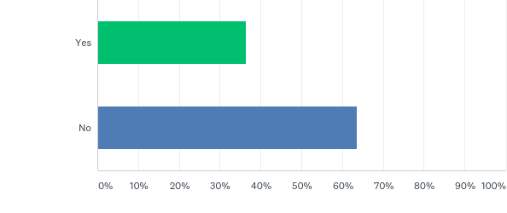
Q26: Do you have any suggestions how to improve the extracurricular services?
Answered: 214 Skipped: 91
- to be analysed later

Slide 29
Thanks to all the parents or students for the participation on the survey!

